Slide 1
Cryptography & Network Security
M.K.Chavan
Computer Science & Engineering Department
WCE, Sangli.
Module-V Network Security
Internet Security Protocols: SSL/TLS
C&NS
MKC

Slide 2
Outline
Web Security and SSL
C&NS
MKC

Slide 3
Web Security
Web now widely used by business, government, individuals
but Internet & Web are vulnerable
have a variety of threats
  integrity
  confidentiality
  denial of service
  authentication
need added security mechanisms
C&NS
MKC

Slide 4
32-2 SSL/TLS
Two protocols are dominant today for providing security at the transport layer: the Secure Sockets Layer (SSL) Protocol and the Transport Layer Security (TLS) Protocol. The latter is actually an IETF version of the former.
Topics discussed in this section:
SSL Services
Security Parameters
Sessions and Connections
Four Protocols
Transport Layer Security

Slide 5
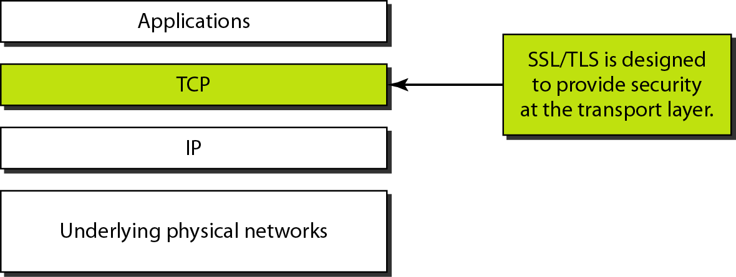
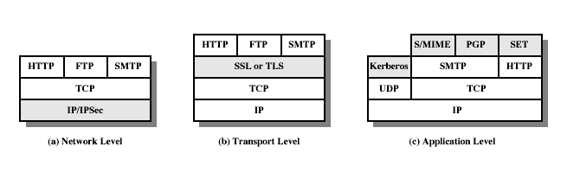
Web Traffic Security Approaches
C&NS
MKC

Slide 6
SSL (Secure Socket Layer)
transport layer security service
originally developed by Netscape
version 3 designed with public input
subsequently became Internet standard known as TLS (Transport Layer Security) (viewed as SSLv3.1)
uses TCP to provide a reliable end-to-end service
SSL has two layers of protocols
C&NS
MKC

Slide 7
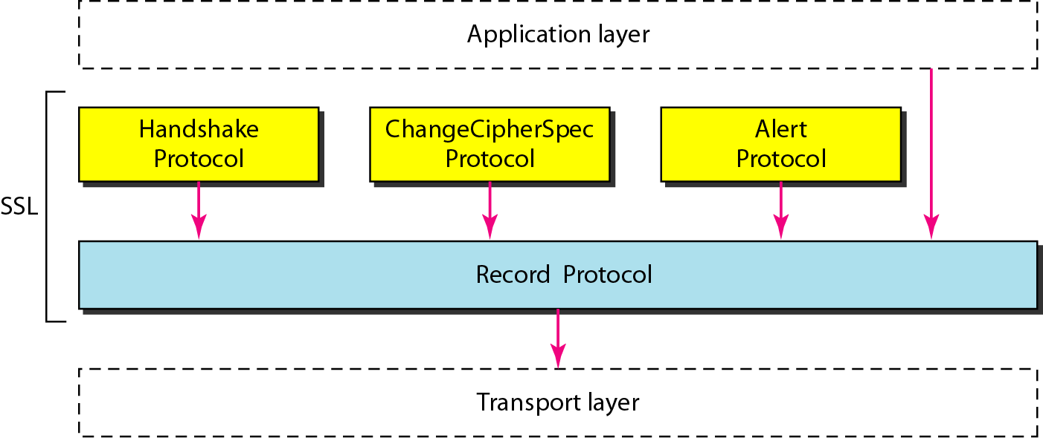
Figure 32.16 Four SSL protocols
32.<number>

Slide 8
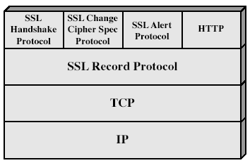
SSL Architecture
C&NS
MKC

Slide 9
SSL (Secure Socket Layer)
SSL Record Protocol: basic security services to higher-layer protocols (HTTP)
Handshake, Change Cipher Spec, Alert: management of SSL exchanges
C&NS
MKC

Slide 10
SSL Session state
Session Identifier: byte sequence chosen by server
Peer certificate X509.v3 certificate
Compression method: compress prior to encryption
Cipher Spec: data encryption algorithm and hash algorithm
Master Secret: 48 byte secret
Is Resumable: can session be used to initiate new connections
C&NS
MKC

Slide 11
SSL Record Protocol
confidentiality
  using symmetric encryption with a shared secret key defined by Handshake Protocol
  IDEA, RC2-40, DES-40, DES, 3DES, Fortezza, RC4-40, RC4-128
  message is compressed before encryption
message integrity
  using a MAC with shared secret key
  similar to HMAC but with different padding
C&NS
MKC
Notes:
SSL Record Protocol defines these two services for SSL connections.

Slide 12
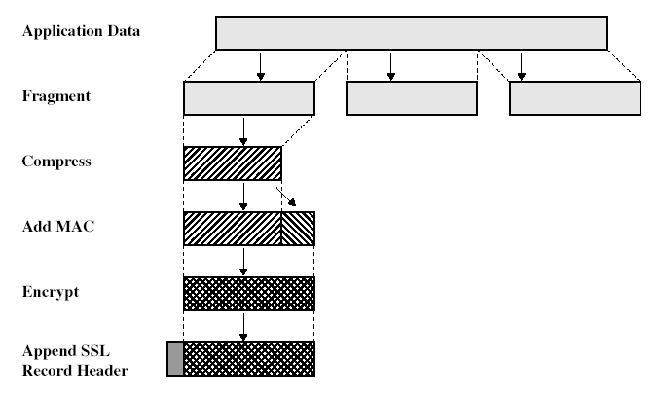
SSL Record Protocol
Fragmentation: blocks of 16384 bytes
Compression: optionally applied and is lossless (current standard default is null)
Padding might be performed after adding the MAC before encryption for block encryption
C&NS
MKC

Slide 13
SSL Change Cipher Spec Protocol
one of 3 SSL specific protocols which use the SSL Record protocol
a single message
causes pending state to become current
hence updating the cipher suite in use
C&NS
MKC

Slide 14
SSL Alert Protocol
conveys SSL-related alerts to peer entity
severity
    warning or fatal
specific alert
    unexpected message, bad record mac, decompression failure, handshake failure, illegal parameter
    close notify, no certificate, bad certificate, unsupported certificate, certificate revoked, certificate expired, certificate unknown
Alert messages are compressed & encrypted like all SSL data
C&NS
MKC

Slide 15
SSL Handshake Protocol
allows server & client to:
  authenticate each other
  to negotiate encryption & MAC algorithms
  to negotiate cryptographic keys to be used
comprises a series of messages in phases
  Establish Security Capabilities
  Server Authentication and Key Exchange
  Client Authentication and Key Exchange
  Finish
C&NS
MKC

Slide 16
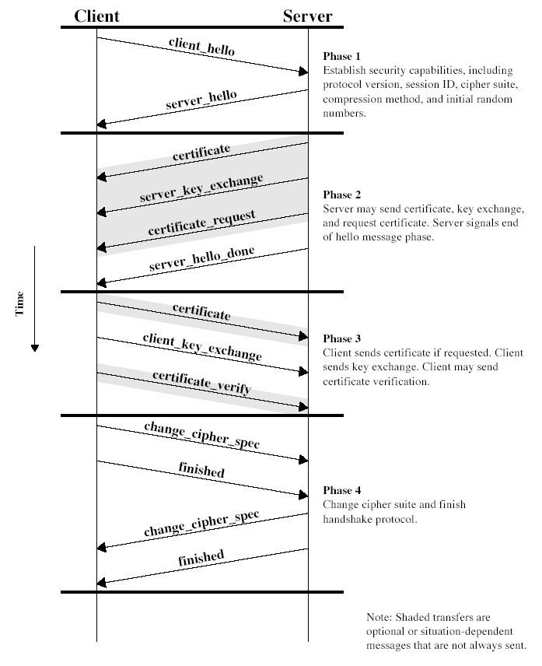
SSL Handshake Protocol
C&NS
MKC
Notes:
Stallings Fig 17-6.

Slide 17
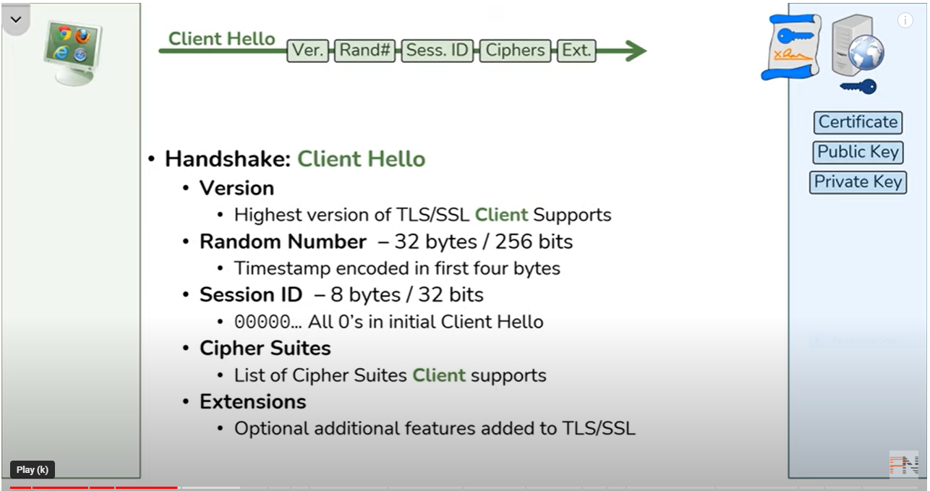
Client Hello Message
Version
Random
  32-bit timestamp and 28 bytes by a secure random number generator
Session ID
  Zero indicates a new connection on a new session
CipherSuite
  A key exchange algorithm and a CipherSpec
  The list is ordered in decreasing order of preference
Compression Method
C&NS
MKC

Slide 18
Server Hello Message
Version
  Lower of version suggested by client and highest supported by server
Random
  32-bit timestamp and 28 bytes by a secure random number generator
Session ID
  Nonzero by client: same used by server
  Zero: value for a new session
CipherSuite
  Single cipher suite selected by server from sent by client
Compression Method
  Compression method selected by server
C&NS
MKC

Slide 19
Key Exchange Methods
RSA
  Secret key encrypted with receiver’s RSA public key
Fixed Diffie-Hellman
  Public key certificate contains Diffie-Hellman public key parameters signed by certificate authority (CA)
  Fixed secret key between two peers
Ephemeral Diffie-Hellman
  Diffie-Hellman public keys are exchanged, signed using sender’s private RSA or DSS key
  Certificates used to authenticate public keys
  Temporary authenticated secret key
Anonymous Diffie-Hellman
Fortezza
C&NS
MKC

Slide 20
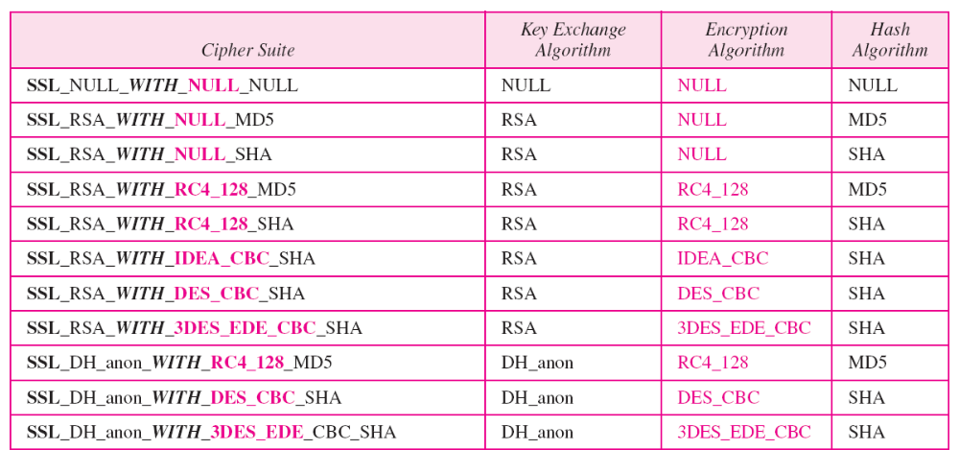
Table 32.3 SSL cipher suite list
32.<number>

Slide 21
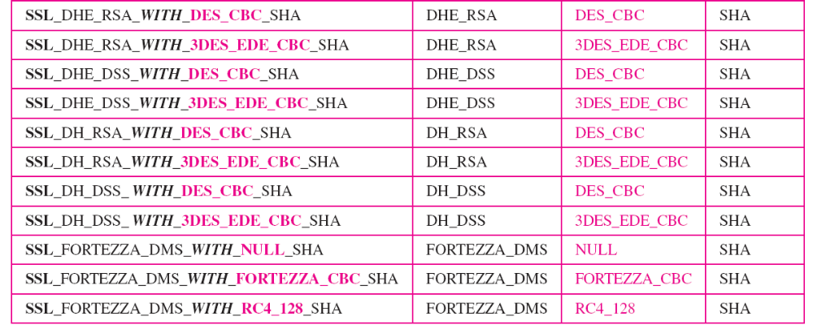
Table 32.3 SSL cipher suite list (continued)
32.<number>

Slide 22
TLS (Transport Layer Security)
IETF standard RFC 2246 similar to SSLv3
with minor differences
  in record format version number
  uses HMAC for MAC
  a pseudo-random function expands secrets
  has additional alert codes
  some changes in supported ciphers
  changes in certificate negotiations
  changes in use of padding
C&NS
MKC

Slide 23

C&NS
MKC

Slide 24



Authenticity of Public Keys
Bob’s key
?
private key
Bob
Alice
public key
Problem: How does Alice know that the public key
she received is really Bob’s public key?
slide <number>

Slide 25
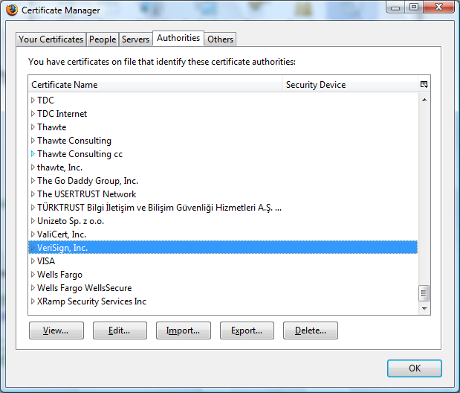
Trusted Certificate Authorities
slide <number>

Slide 26
CA Hierarchy
Browsers, operating systems, etc. have trusted root certificate authorities
  Firefox 3 includes certificates of 135 trusted root CAs
A Root CA signs certificates for intermediate CAs, they sign certificates for lower-level CAs, etc.
  Certificate “chain of trust”
    sig_{Verisign}(“UT Austin”, PK_{UT}), sig_{UT}(“Vitaly S.”, PK_{Vitaly})
CA is responsible for verifying the identities of certificate requestors, domain ownership
slide <number>

Slide 27
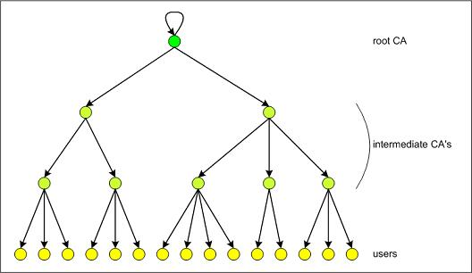
Certificate Hierarchy
What power do they have?
Who trusts their certificates?
slide <number>

Slide 28
Alternative: “Web of Trust”
Used in PGP (Pretty Good Privacy)
Instead of a single root certificate authority, each person has a set of keys they “trust”
  If public-key certificate is signed by one of the “trusted” keys, the public key contained in it will be deemed valid
Trust can be transitive
  Can use certified keys for further certification
I trust
Alice
sig_{Alice}(“Friend”, Friend’s key)
sig_{Friend}(“FoaF”, FoaF’s key)
Friend of Alice
Bob
Alice
Friend of friend
slide <number>

Slide 29
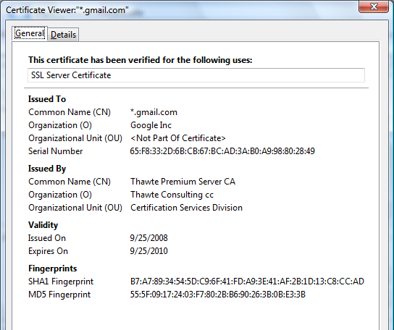
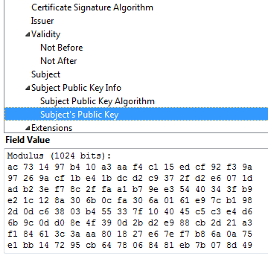
Example of a Certificate
Important fields
slide <number>

Slide 30
X.509 Authentication Service
Internet standard (1988-2000)
Specifies certificate format
  X.509 certificates are used in IPsec and SSL/TLS
Specifies certificate directory service
  For retrieving other users’ CA-certified public keys
Specifies a set of authentication protocols
  For proving identity using public-key signatures
Can use with any digital signature scheme and hash function, but must hash before signing
Remember MD5?
slide <number>

Slide 31
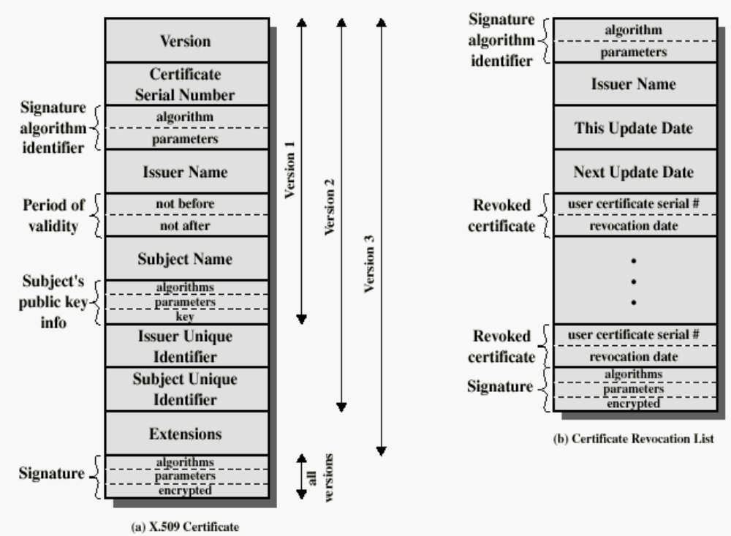
X.509 Certificate
Added in X.509 versions 2 and 3 to address
usability and security problems
hash
slide <number>

